Slide 1
Many Flavors of Arduino

Slide 2
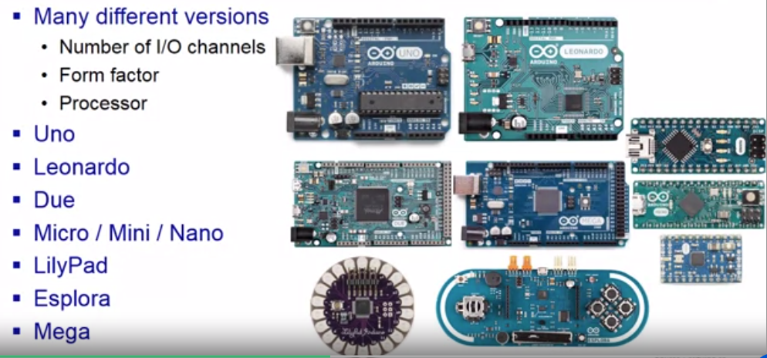
Many Flavors of Arduino(1/5)

Slide 3
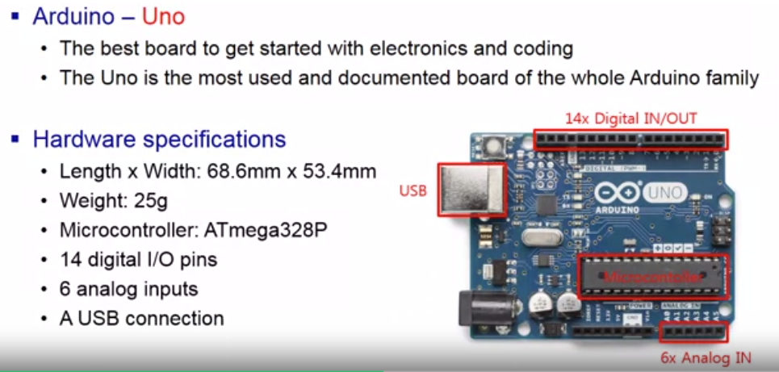
Many Flavors of Arduino(2/5)

Slide 4
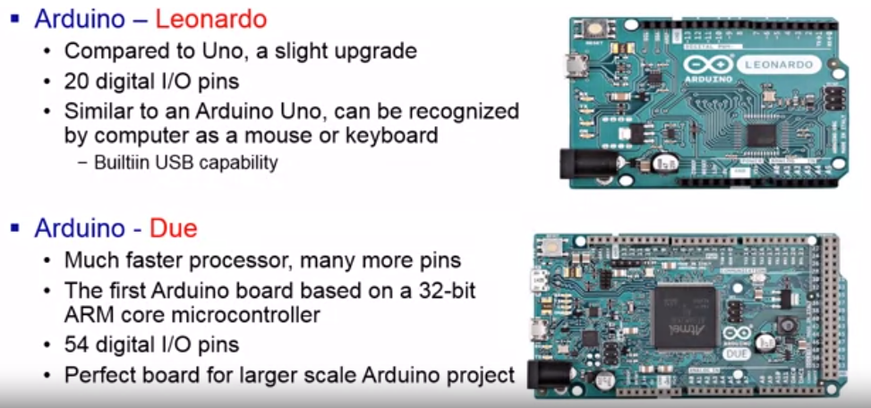
Many Flavors of Arduino(3/5)

Slide 5
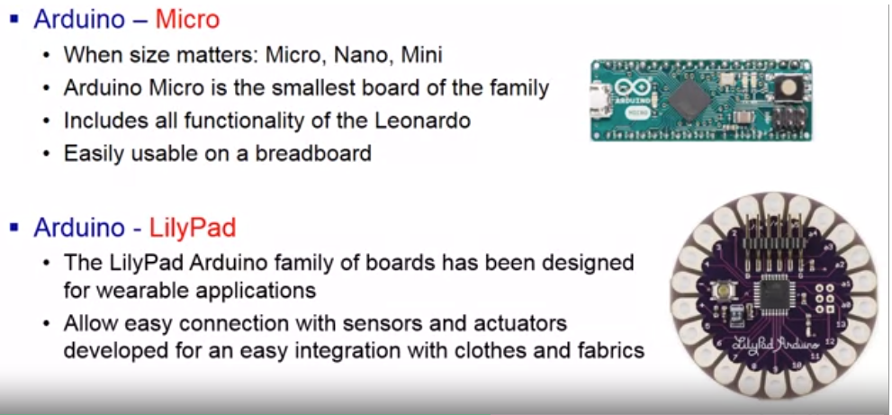
Many Flavors of Arduino(4/5)

Slide 6
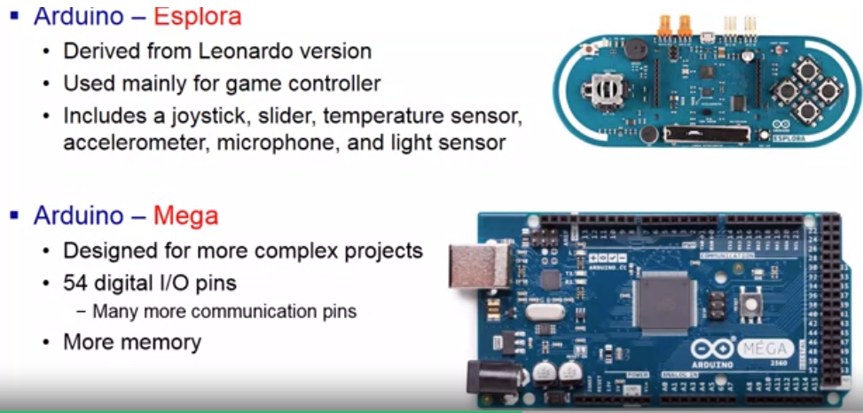
Many Flavors of Arduino(5/5)

Slide 7
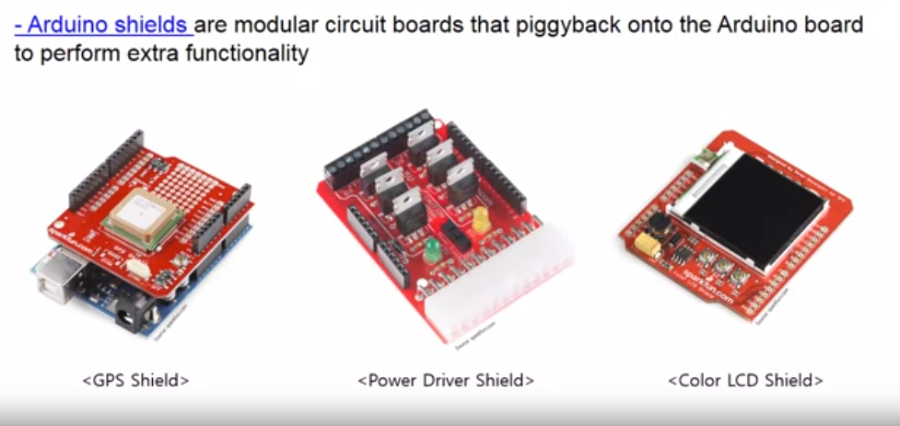
Arduino Add-ons (Shields)

Slide 8
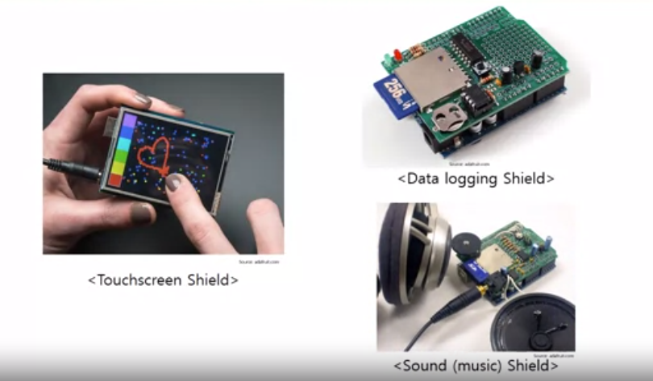
Arduino Add-ons (Shields)

Slide 9
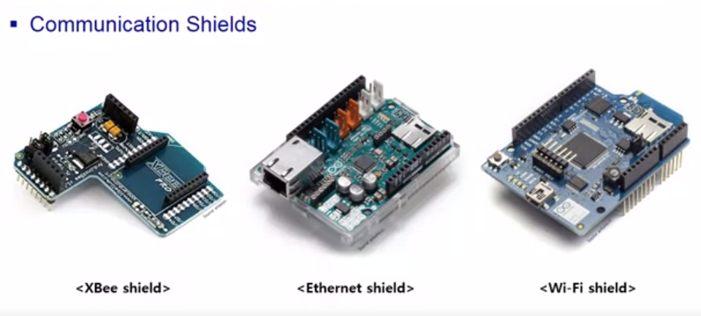
Arduino Add-ons (Shields)

Slide 10
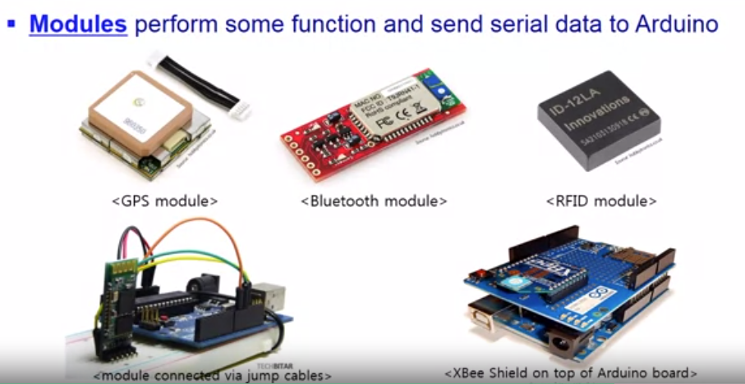
Arduino Add-ons (Modules)

Slide 11
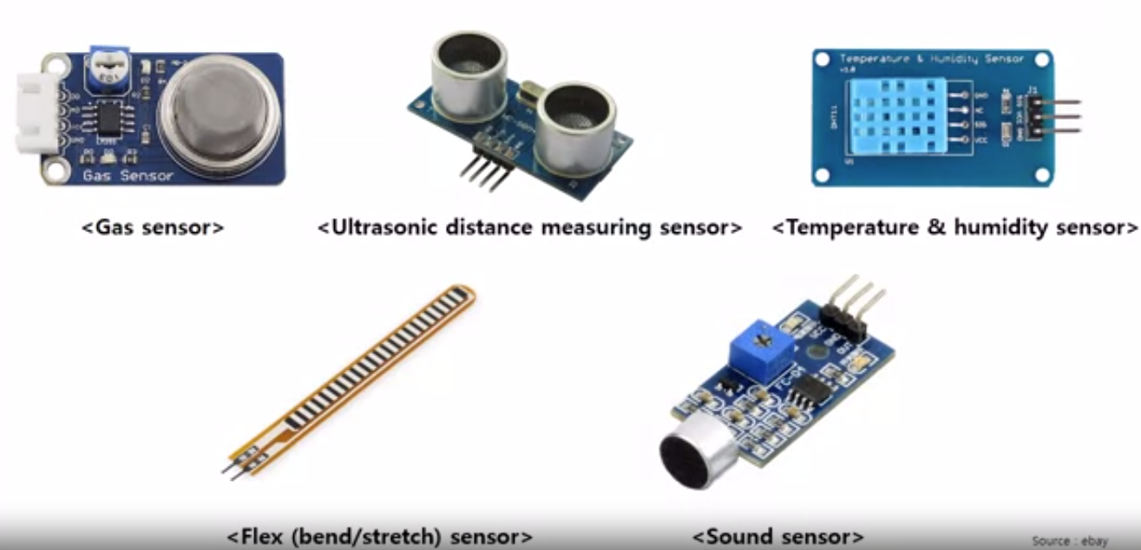
Arduino Add-ons (Sensors)

Slide 12
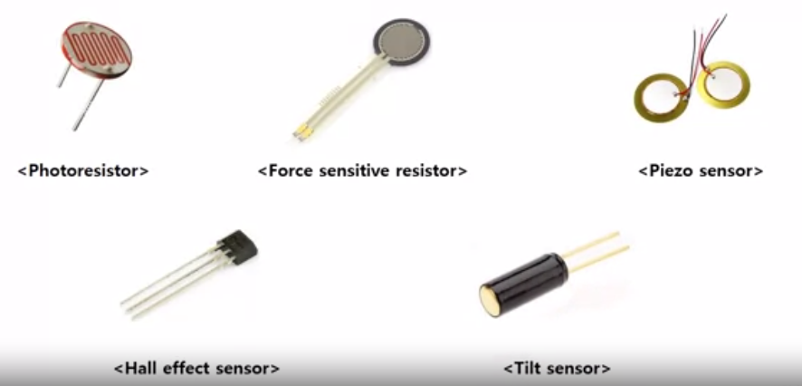
Arduino Add-ons (Sensors)

Slide 13
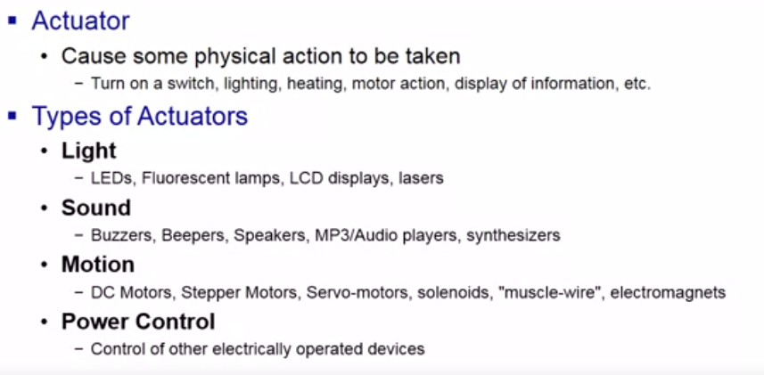
Arduino Add-ons (Actuators)

Slide 14
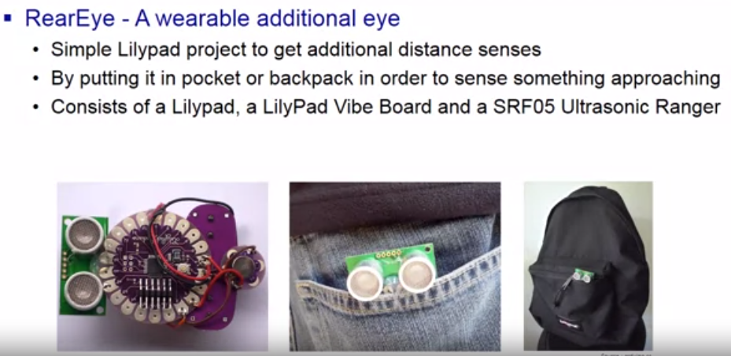
Arduino Projects(1/2)

Slide 15
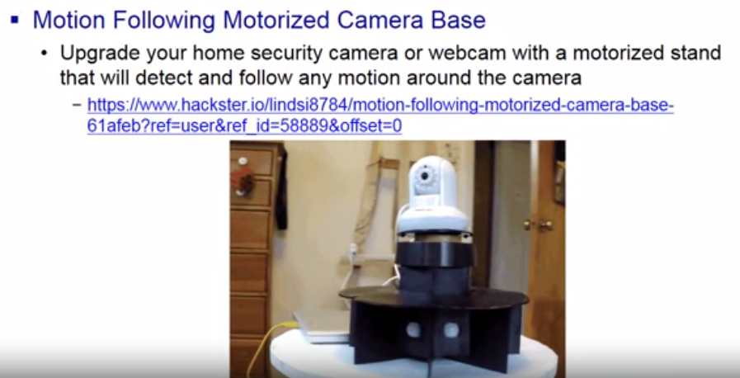
Arduino Projects(2/2)

Slide 16
Other Interesting Projects
LED matrix for processing
Arduino flash control
Google earth walk
Ultrasonic grass

